Slide 1
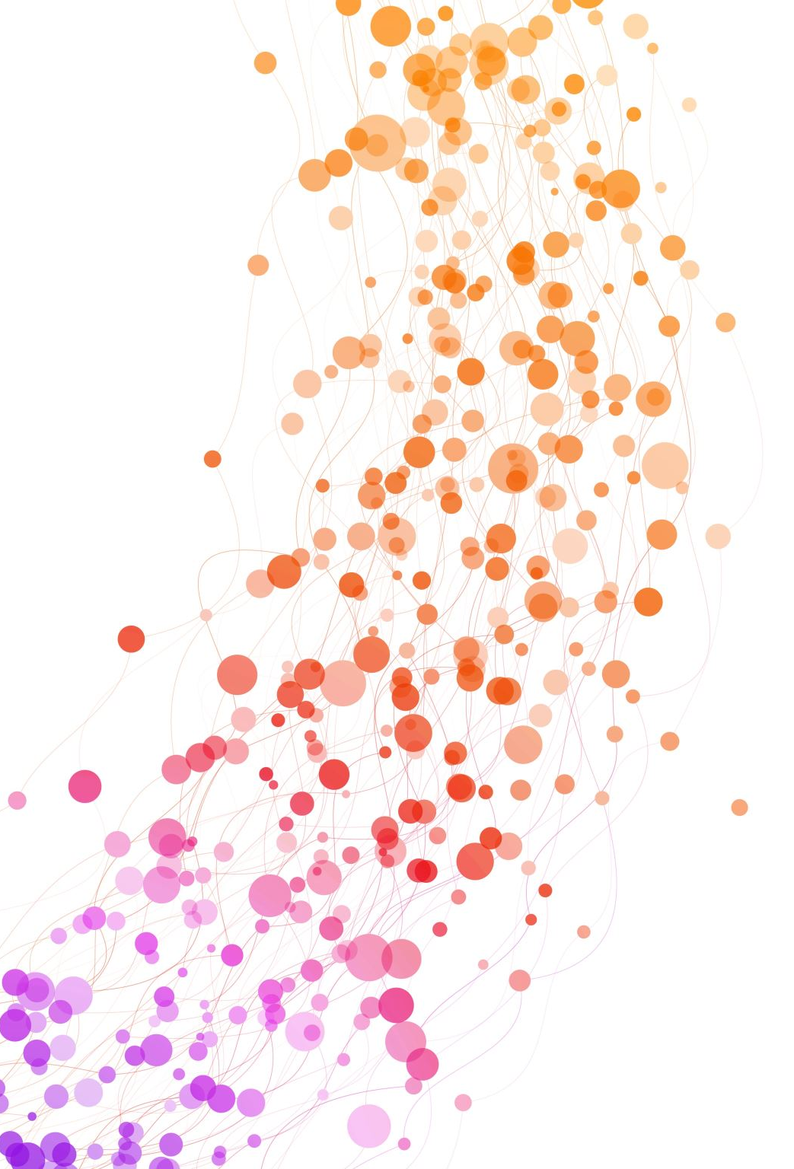
Deep Learning Bootcamp 4
Sequence data and Sequence modeling
Speakers: Alka Luqman & Tu Ngo

Slide 2
Sequence data
The data points, or the elements of each data points are arranged in specific sequence / chronological order.

Slide 3
Sequence data
Time series
Text
Speech
Music
DNA sequences
Video frames
User clicking

Slide 4
Sequence modeling

Slide 5

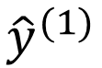
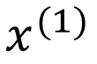
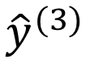
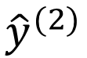
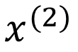
Problem with feed-forward NN
$${\hat{y}}^{(1)}$$
$$x^{(1)}$$
$${\hat{y}}^{(2)}$$
$$x^{(2)}$$
$${\hat{y}}^{(3)}$$

Slide 6
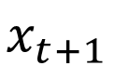
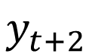
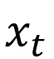
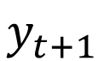
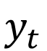
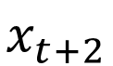
Inputs with time steps
$$y_{t}$$
$$y_{t+1}$$
$$y_{t+2}$$
$$x_{t}$$
$$x_{t+1}$$
$$x_{t+2}$$

Slide 7
Limitations of RNNs
Information bottleneck
Slow, no parallelization
Struggle to capture long-term memory

Slide 8
We desire something even better…
Information bottleneck Continuous stream
Slow, no parallelization
Struggle to capture long-term memory

Slide 9
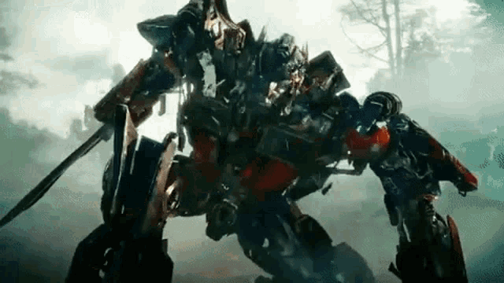
Sequence model evolution
Recurrent networks
Breakthrough!!!
Groundbreaking!!!
Vanila RNN
LSTM
GRU
Transformer
Context = 250-500 words
Context = 10k words
Context length :
GPT1 = 512 words
GPT2 = 1024 words
GPT3 = 2048 words
GPT4 = 128k words (>300 pages)

Slide 10
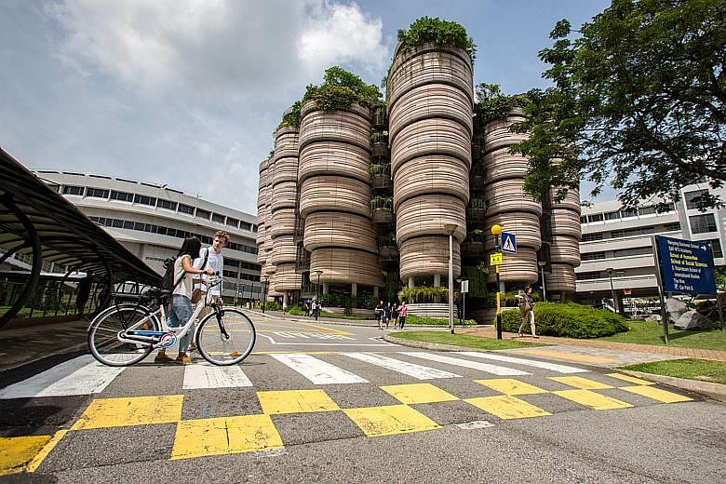
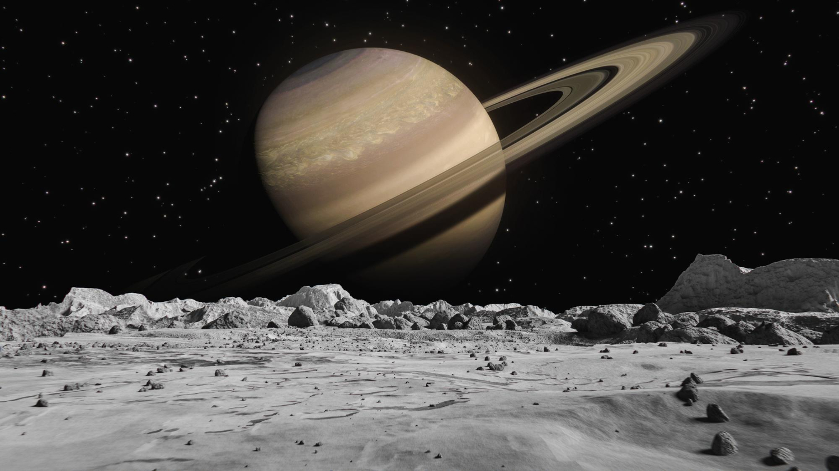
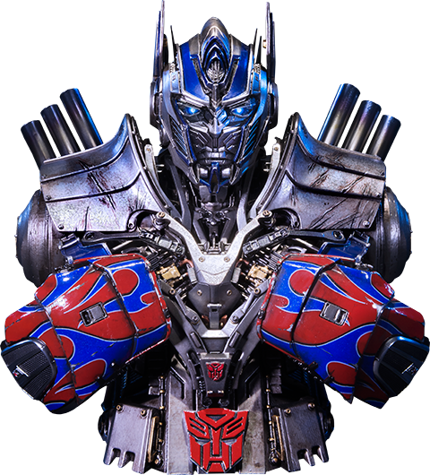

Attention is all you need

Slide 11
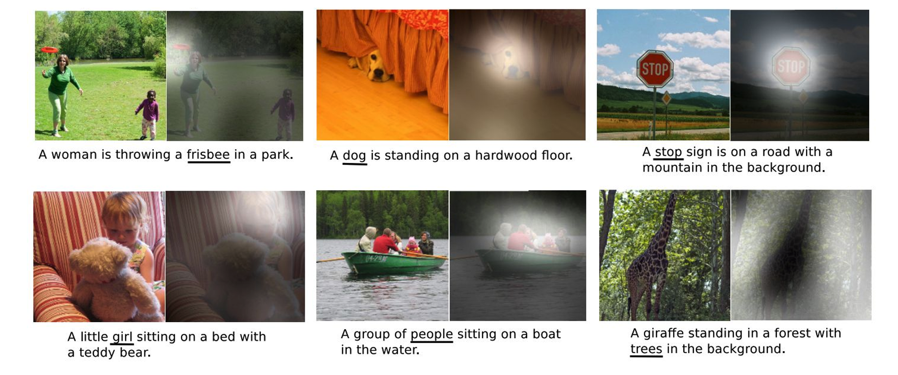
Attention is all you need
Image captioning with Attention

Slide 12
Attention is all you need
Revisit Seq2Seq recurrent network (no attention yet)
I
am
a
student
<END>
Encoder
Decoder
Je
suis
étudiant
<START>
I
am
a
student

Slide 13
Attention is all you need
Looking at the first decoder time step
I
Encoder
Decoder
Je
suis
étudiant
<START>
The last Encoder hidden state is fed to the Decoder

Slide 14
Attention output
Now, we try to pay attention!
Probability
distribution
I
Decoder
Encoder
Je
suis
étudiant
<START>

Slide 15
Attention output
Now, we try to pay attention!
I
am
Probability
distribution
Decoder
Encoder
Je
suis
étudiant
<START>
I

Slide 16
Attention output
Now, we try to pay attention!
I
am
a
Probability
distribution
Decoder
Encoder
Je
suis
étudiant
<START>
I
am

Slide 17
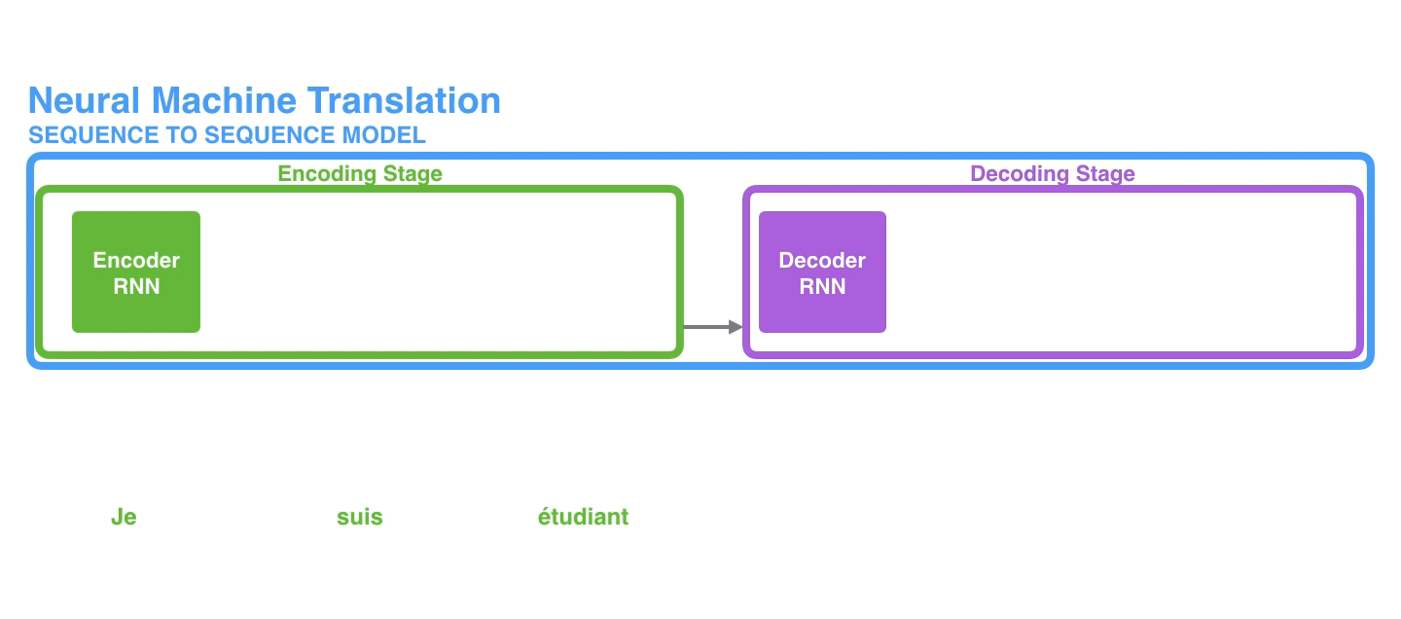
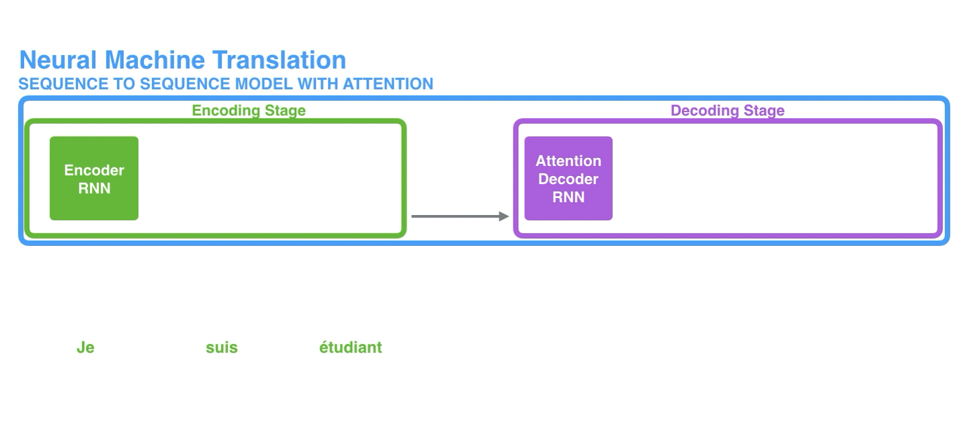
Attention is all you need
No Attention
With Attention

Slide 18
Self-attention
Traditional attention: between encoder and decoder, good for sequence-to-sequence task such as machine translation.
How about leveraging attention for learning representation?
-> ATTENTION with itSELF

Slide 19
Self-attention
FFNN
FFNN
FFNN
FFNN
embed
embed
embed
embed
This
is
our
bootcamp
*FFNN: Feedforward neural network

Slide 20
Self-attention
FFNN
FFNN
FFNN
FFNN
embed
embed
embed
embed
This
is
our
bootcamp
*FFNN: Feedforward neural network

Slide 21
Self-attention
FFNN
FFNN
FFNN
FFNN
embed
embed
embed
embed
This
is
our
bootcamp
*FFNN: Feedforward neural network

Slide 22
Self-attention
Previously we did one-head self-attention
FCNN
Self-attention
embed
This is our bootcamp

Slide 23
Multi-head self-attention
Q: How to create multi heads?
A: Just stack lah
Concatenate
FCNN
Self-attention
Self-attention
Self-attention
embed
This is our bootcamp

Slide 24
Multi-head self-attention
Multiple heads expand the model’s capability to focus on different parts of the sentence.
Improve the diversity of representation learning: each head tries to learn different representation subspaces of the input embeddings.

Slide 25

Are the issues resolved?
Information bottleneck : attention takes all input positions into account.
Slow, no parallelization : attention allows parallel computation (matrix multiplication).
Struggle to capture long-term memory : also related to resolve information bottleneck.

Slide 26
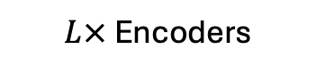
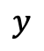
Transformer block
Embedding
Encoder
…
$L×$ Encoders
Encoder
Classifier
$$y$$

Slide 27

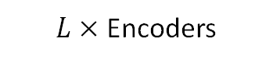
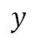
Transformer block
Embedding
Norm
Zoom +
Multi-head Attention
Encoder
…
+
$L×$ Encoders
Encoder
Norm
Feed-forward
Classifier
+
$$y$$

Slide 28
Transformer block
Norm
Multi-head Attention
Multi-head Attention
Concatenate
Zoom ++
+
Norm
FCNN
Self-attention
Feed-forward
Self-attention
Self-attention
+
Embeddings

Slide 29
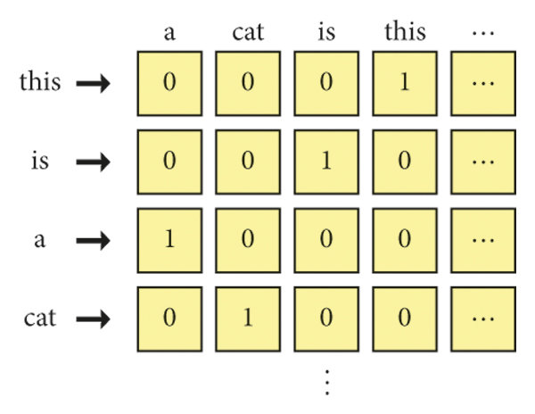
One Hot Encoding

Slide 30
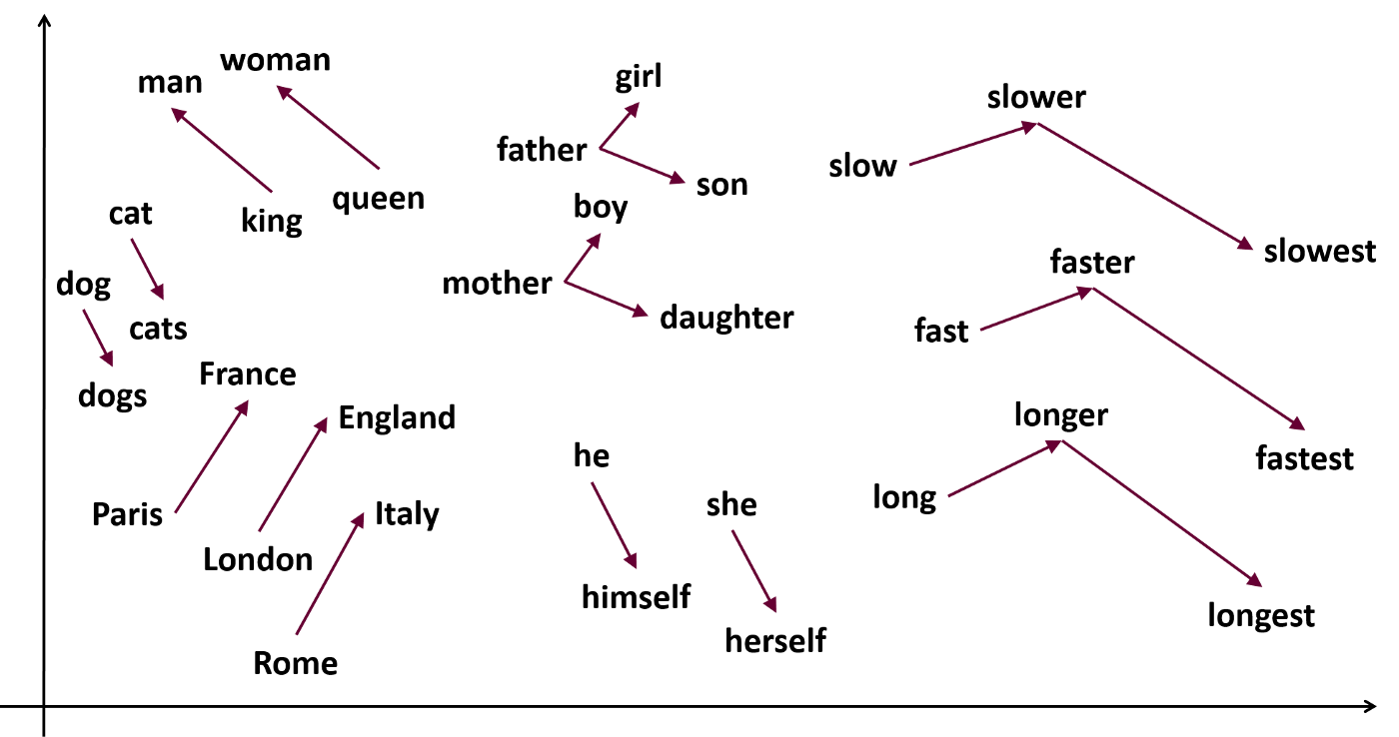
Word2Vec

Slide 31
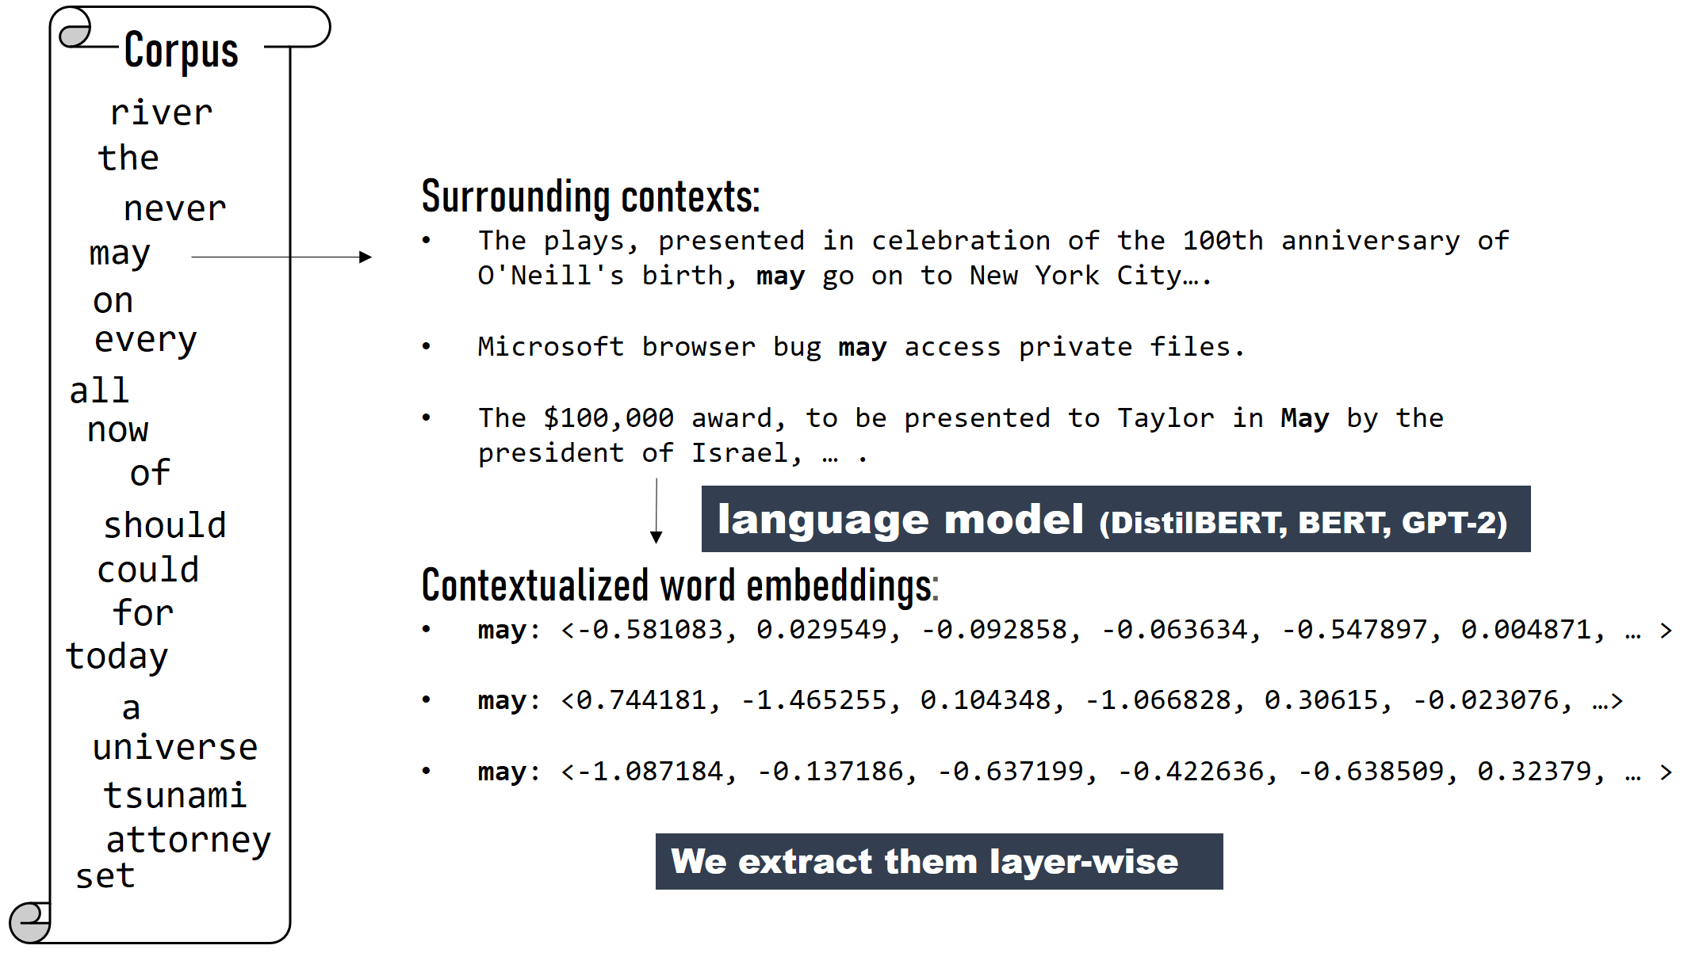
BERT Embedding

Slide 32
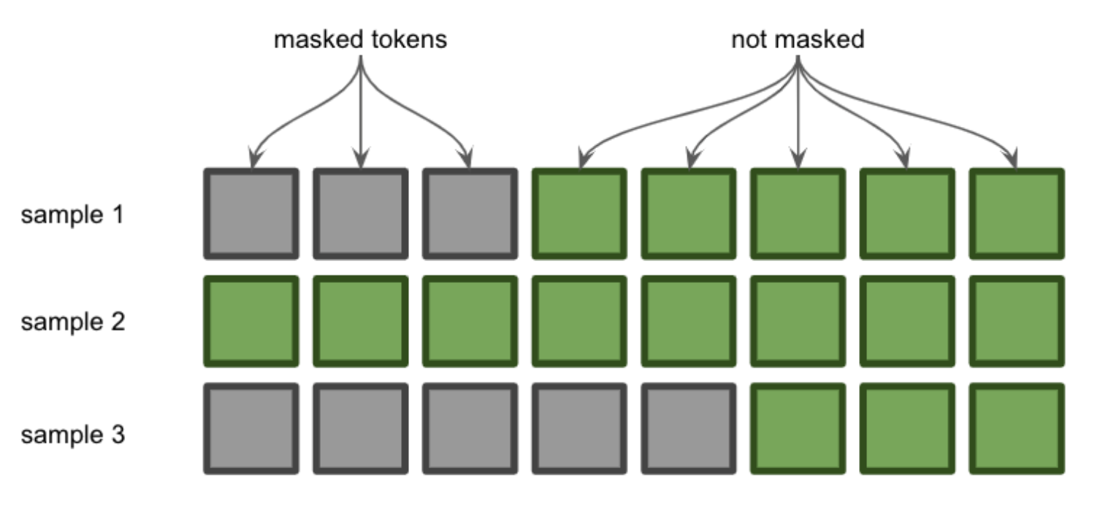
BERT Embedding – Attention Masks

Slide 33
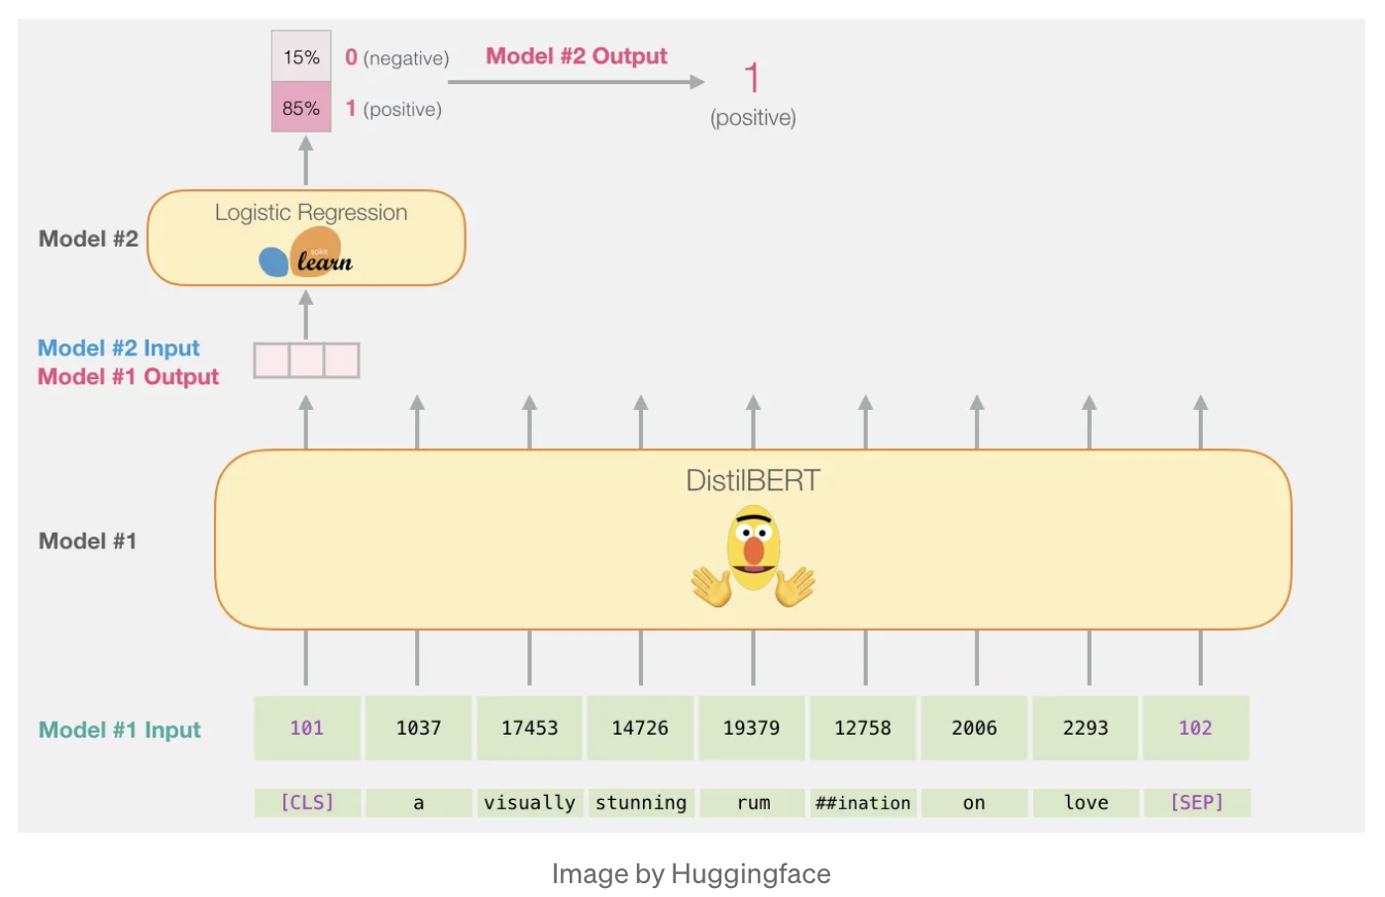
BERT for Classification

